Slide 2
explore concepts of SPLUNK,
learn features of Splunk,
understand Interfaces and data ingestion.

Slide 3

Introduction

Slide 4
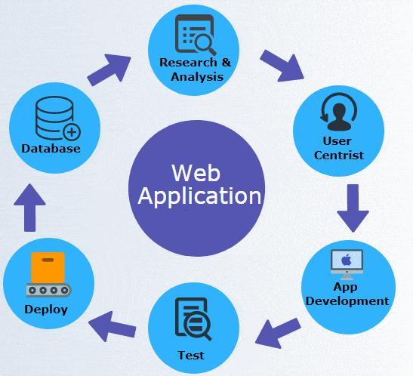
Introduction

Slide 5

Introduction
Sensors

Slide 6
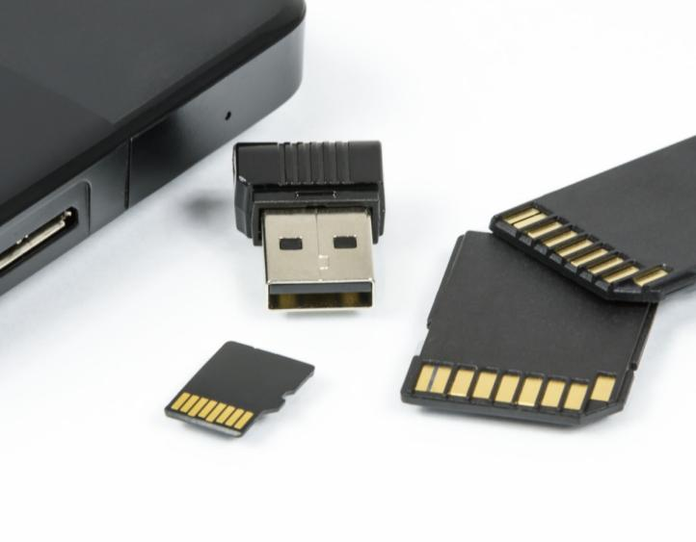
Introduction
Data

Slide 7
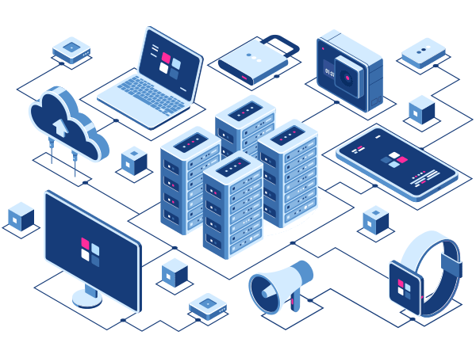
IT Infrastructure

Slide 8
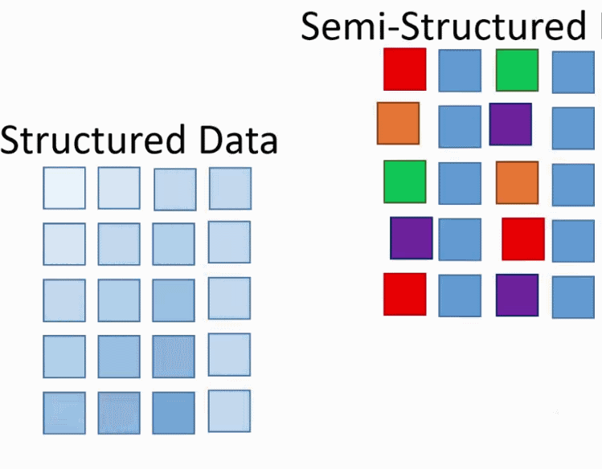

Slide 9
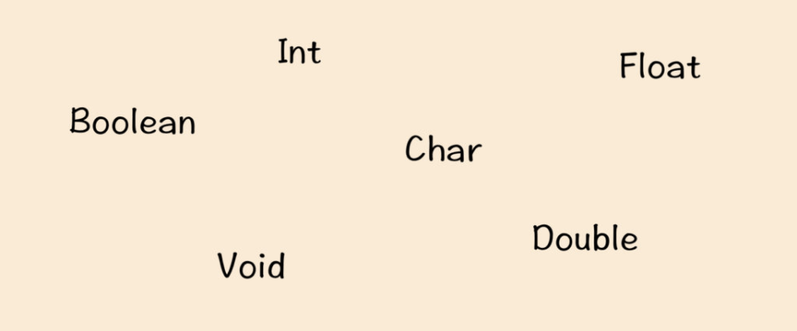
Introduction
Built-in feature to recognize data types

Slide 10
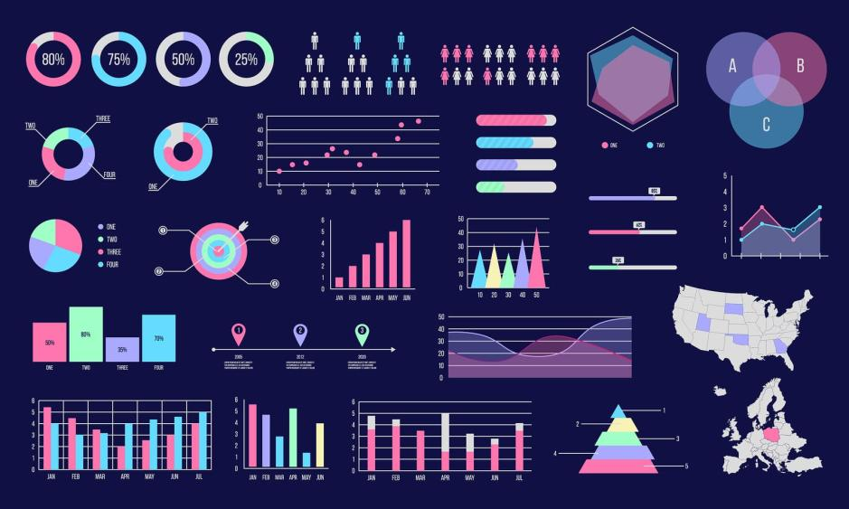
Introduction
Data Visualization

Slide 11
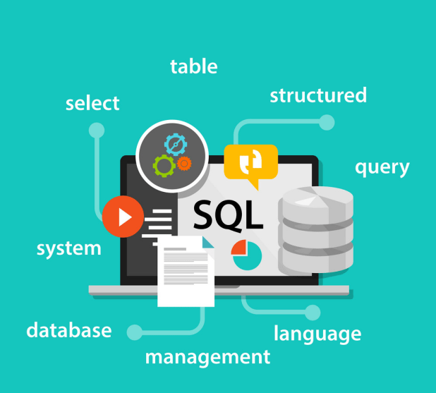
Prerequisites
Structured Query Language

Slide 12
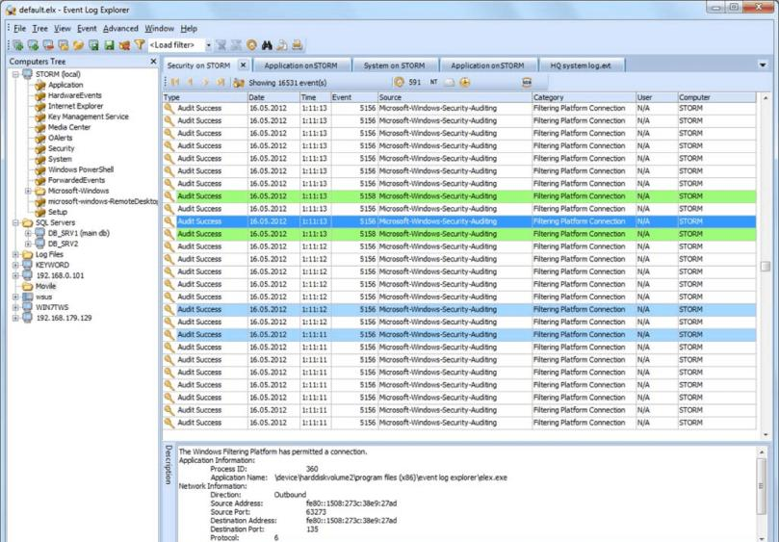
Prerequisites
Log

Slide 13
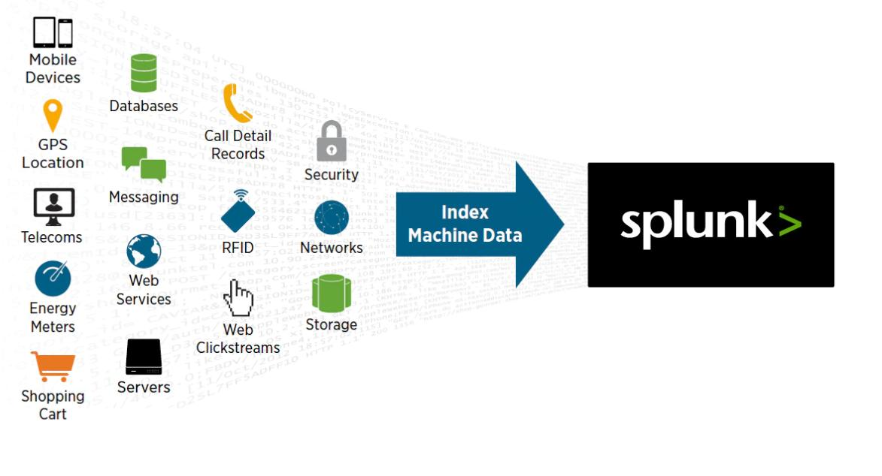
Prerequisites

Slide 14

Prerequisites
Splunk can read this unstructured, semi-structured or rarely structured data

Slide 15
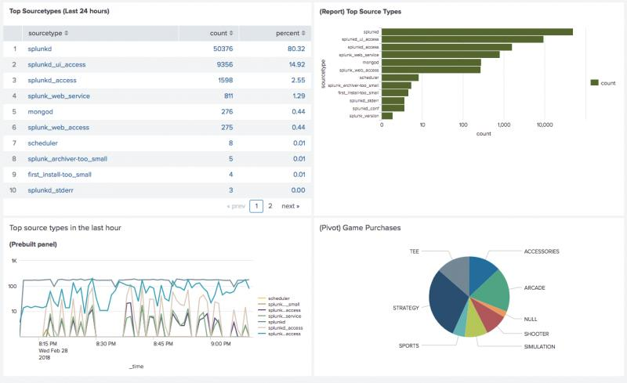
Prerequisites
search, tag, create reports and dashboards on these data.

Slide 16
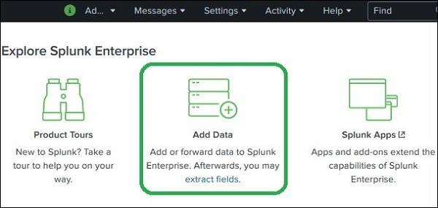
Prerequisites
General analytical tool for unstructured machine data and various forms of big data.

Slide 17
Product Categories
Splunk is available in three different product categories

Slide 18
Product Categories
Splunk Enterprise
Splunk is available in three different product categories

Slide 19
Product Categories
Splunk Enterprise
Splunk is available in three different product categories
Splunk Cloud

Slide 20
Product Categories
Splunk is available in three different product categories
Splunk Enterprise
Splunk Cloud
Splunk Light

Slide 21
Splunk Features
Data Ingestion
Data Indexing
Data Searching
Using Alerts
Dashboards
Data Model

Slide 22
Splunk Interface

